Slide 1
Logging into Envision Math

Slide 2
Website
Go to: https://www.pearsonrealize.com/index.html#/
Or use the app shortcut:

Slide 4
Enter the student’s username and password

Slide 5
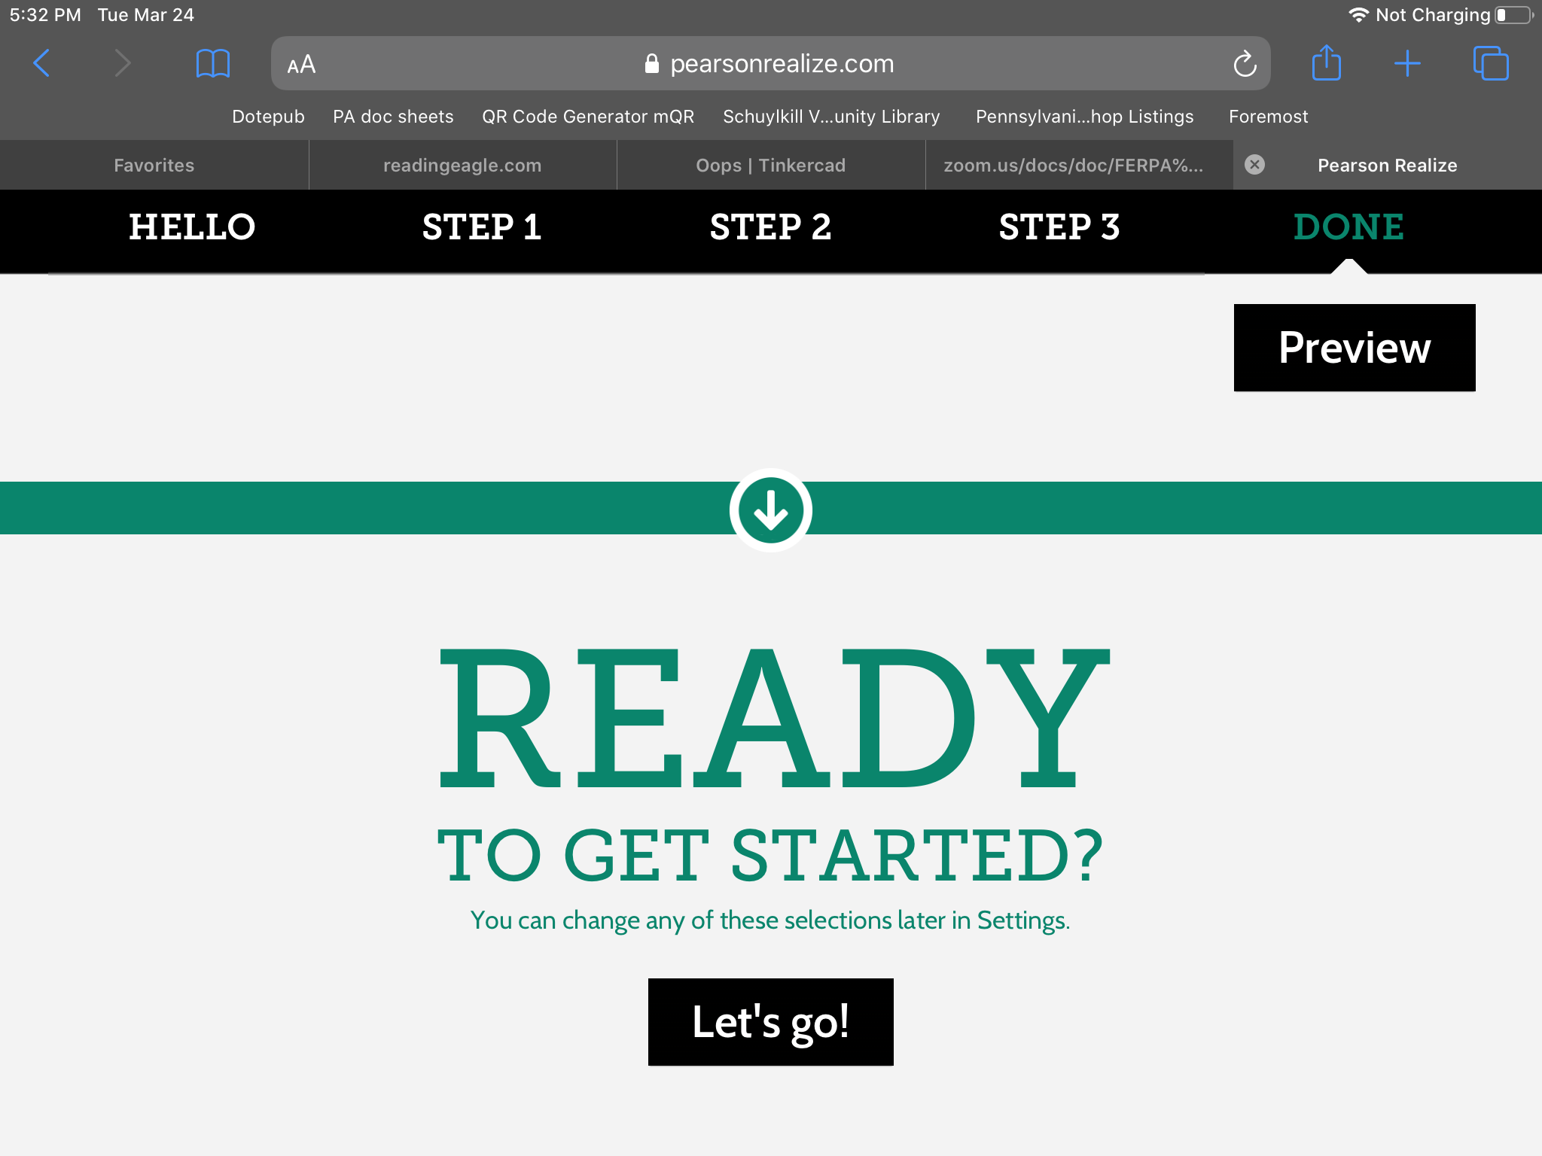
Set up
You will have to set up his/her personalization.
He/she can choose an icon and background image. Then scroll to the bottom and tap “Let’s Go!”

Slide 6
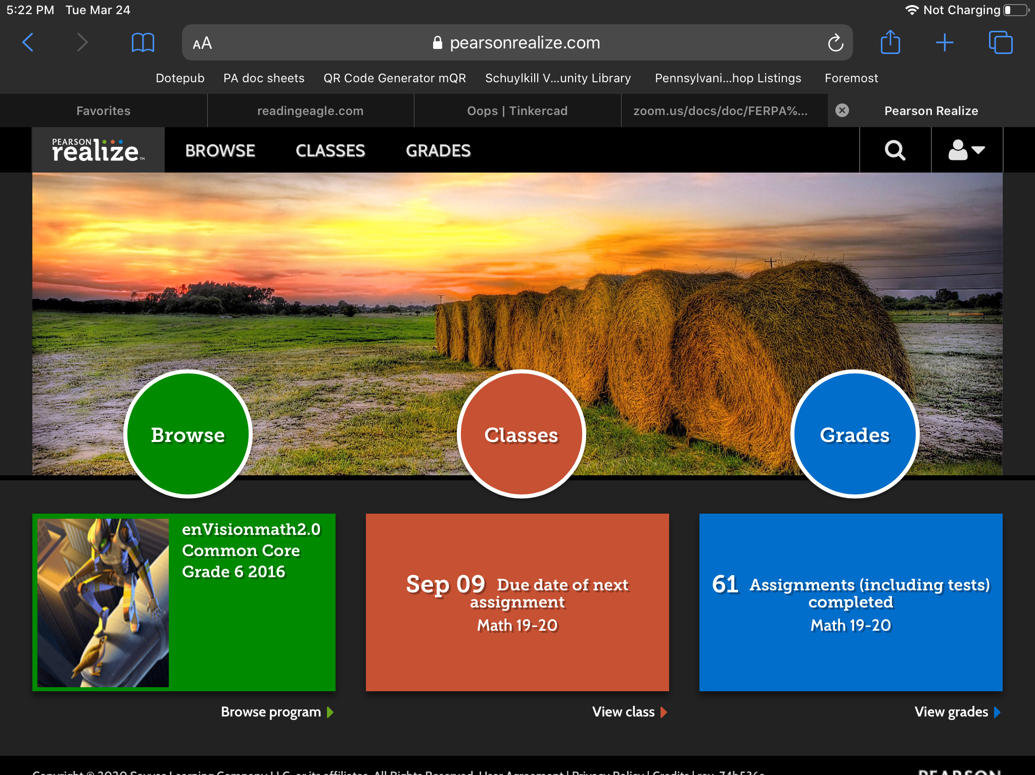
Tap Classes

Slide 7
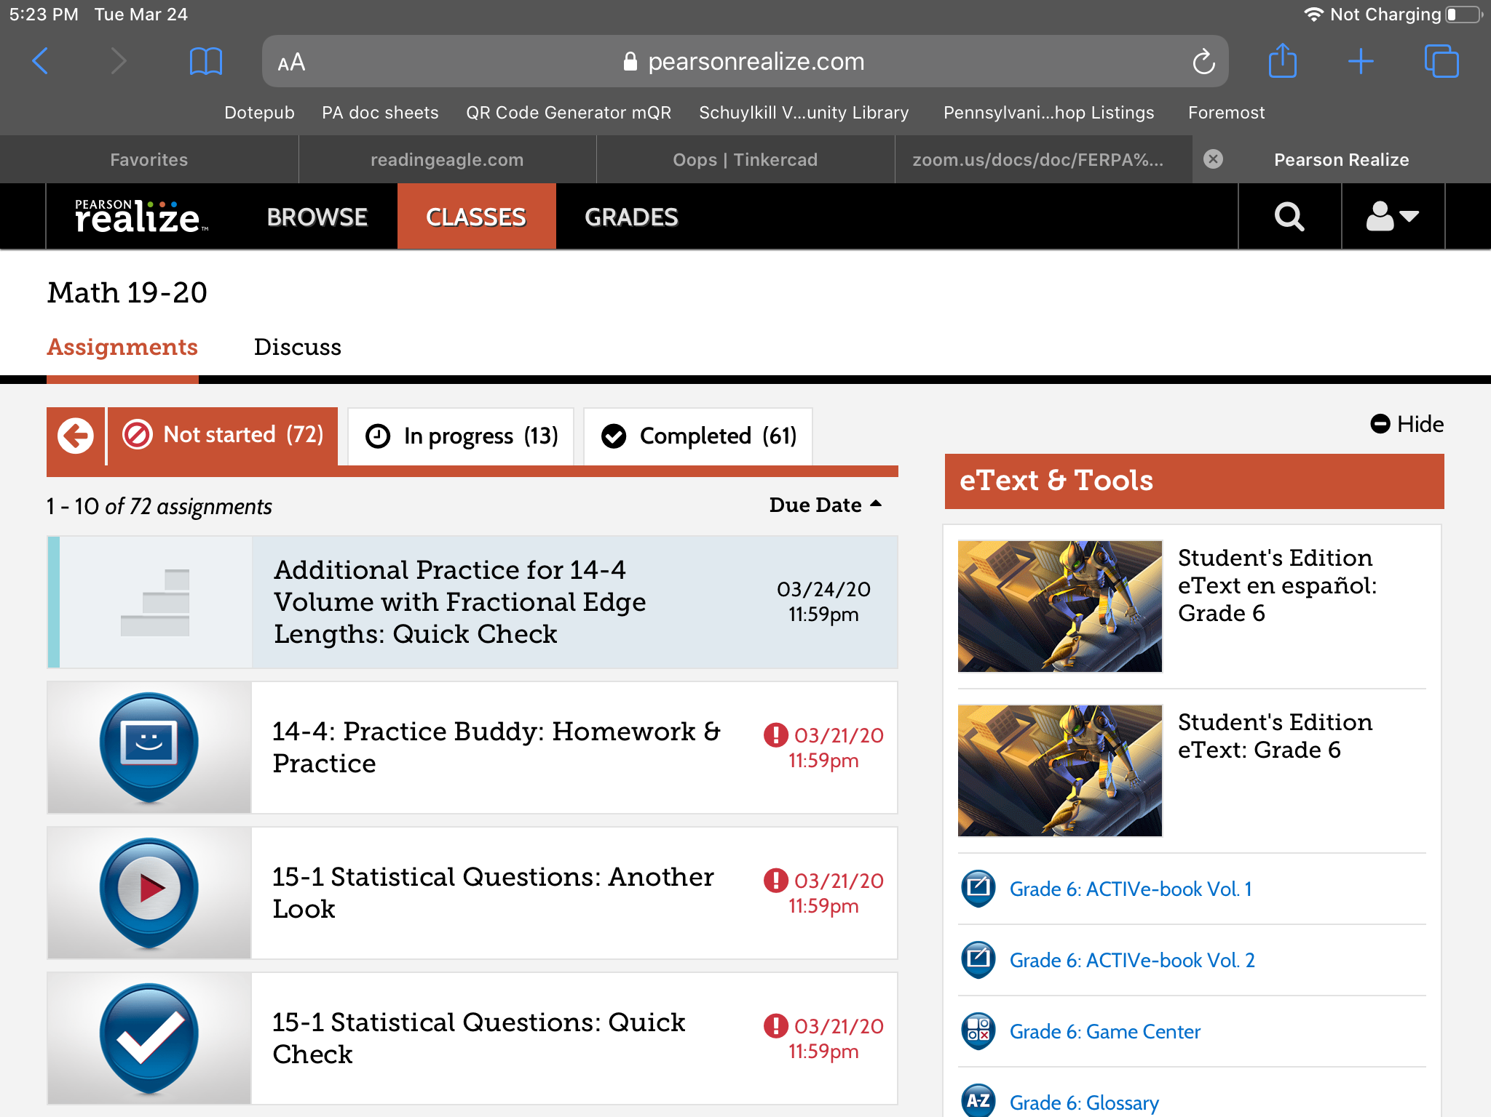
Use Classes to return to this screen

